Slide 1
Dig It
Andrea Ortino - 40270115
Giovanni Paolini - 40276003
A game about dwarves looking for a treasure

Slide 2





Game Concept
Dig It is a top-down 2D game where the player can decide his/her path through a maze-like mine by destroying the rocks around him/her.
Some of the destroyed rocks will spawn mysterious objects, ghosts, or the so desired treasure!
Claim your treasure and protect it.
But this won’t be easy:
- Ghosts haunt in the inner parts of the mines.
- Other greedy players are looking for the treasure.
The player should experience a sense of discovery, challenge, and competition.

Slide 3
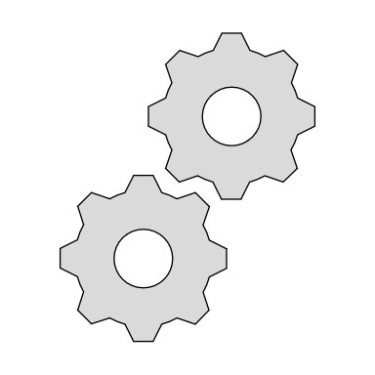
Core Mechanics
Dig: the player destroys a tile with 1 or multiple hits.
Steal: the player can steal the treasure from other players (only in multiplayer mode).
Use an Object: the player can use an object he collected. Its effect would depend on the type of objects. Only one object can be held at a time and it will be consumed after use.
Ghosts: the player cannot kill the ghosts, but they will catch him/her causing a respawn.
Respawn: the player will start at the beginning of the level and will be able to move after 2 seconds.

Slide 4

Gameplay Flow
Single and competitive multiplayer modes
Other players will be able to steal the treasure
The player can “Dig” and create new path in the maze-like cavern
When a player finds the treasure, he/she must protect it from the other players for 30 seconds to win
Random elements, like objects, ghosts, or the treasure, will spawn after destroying each tile
No interactions between players, unless…
The Treasure spawns only in the inner sections of the level.
Ghosts haunt the inner areas

Slide 5
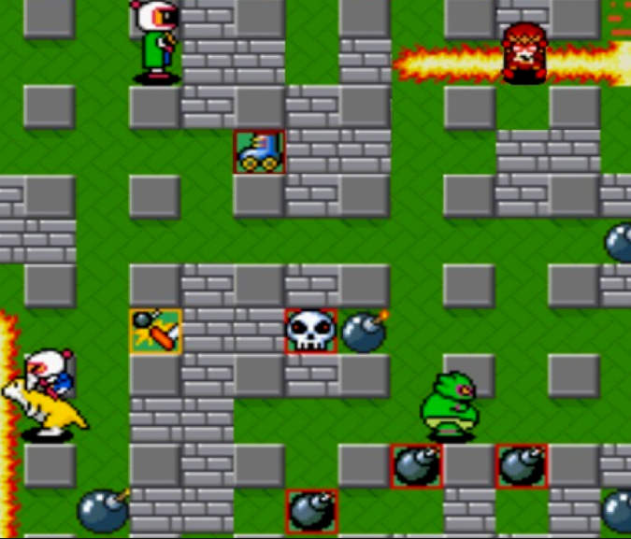
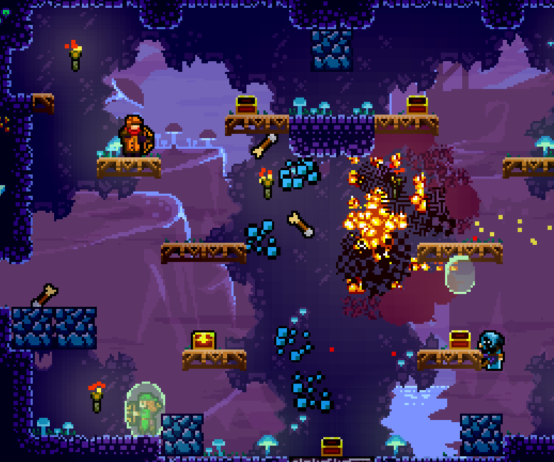
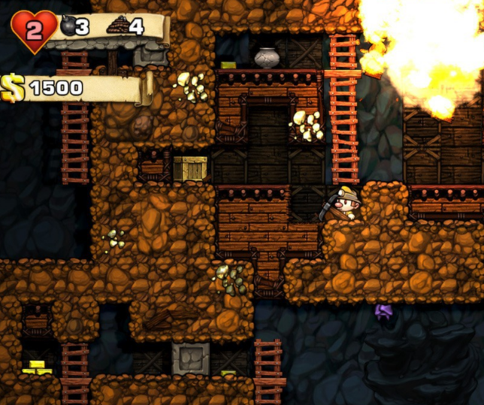
inspirations
Bomberman
TowerFall
Spelunky
…and the classic “Tag” game (reversed)

Slide 6

Future ideas to consider
Use of sprites for the dwarves/ghosts (the first development stage will use simple shapes for characters and enemies).
Adding random items (powerups, weapons, etc.)
Adding other types of enemies (“killable” monsters in order to support temporary cooperation for the players).
More maps (considering procedural generated maps).
Different winning conditions/modes.

Slide 7
Thanks for the attention
dig it

